Slide 1
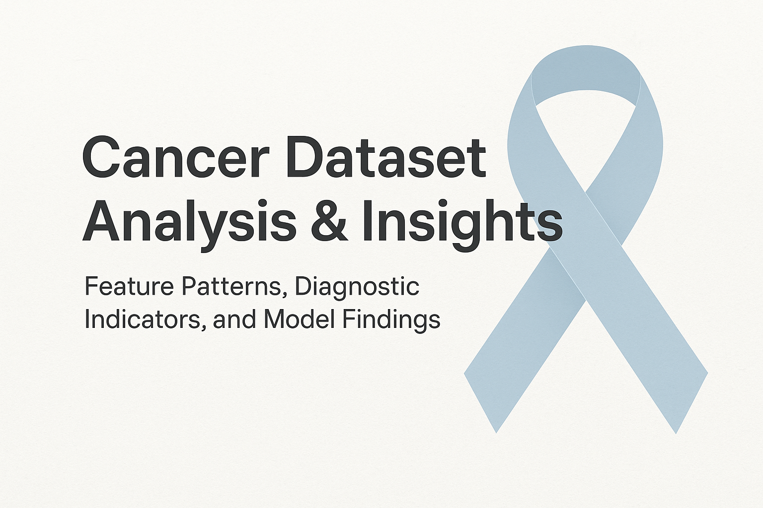
Sylvester Kyeremeh
12th Dec 2025

Slide 2

Executive Summary
Cancer diagnosis often hinges on catching the subtle early signs hidden inside cell structures – signs that can mean the difference between timely treatment and missed opportunity
This analysis set out to uncover those patterns: the characteristics that consistently separate benign from malignant samples, and whether learning can help amplify clinical decision-making
These findings reveal a clear story of irregularity, structure breakdown and diagnostic signals that appear across multiple features – all pointing towards the same conclusion: cancer leaves footprints and those footprints can be detected

Slide 3
Objectives
Every good investigation starts with guiding questions
What makes malignant cells look different?
Which features are largest indication of dangers?
Can we train models to recognize these signs reliably?

Slide 4
Dataset Overview
Before the story unfolds we must understand the cast of characters – the features
We examined measurements such as cell size, shape, nuclei structure, nucleoli prominence, chromatin, uniformity, and more
Each feature plays a role in revealing how a cell behaves, how it mutates, and how it signals abnormal growth
The dataset provides a balanced starting point for uncovering this hidden narrative.

Slide 5
EDA Summary
As we explored the data, patterns started to surface.
Like detectives examining early clues, we noticed the malignant samples consistently push the boundaries of normal behavior – higher variation, more disorder, more irregularity
These early impressions hinted that our story would not rely on one feature alone, but on a chorus of indicators.

Slide 6
Boxplots & Violin Plots: Benign vs Malignant
Visualizing each feature side-by-side revealed striking truth: malignant cells rarely hide their chaos.
Cell shape, size, nucleoli prominence, chromatin patterns – all show a dramatic shift compared to benign cells.
These boxplots act like visual testimonies, showing the widening gap between normalcy and malignancy

Slide 7
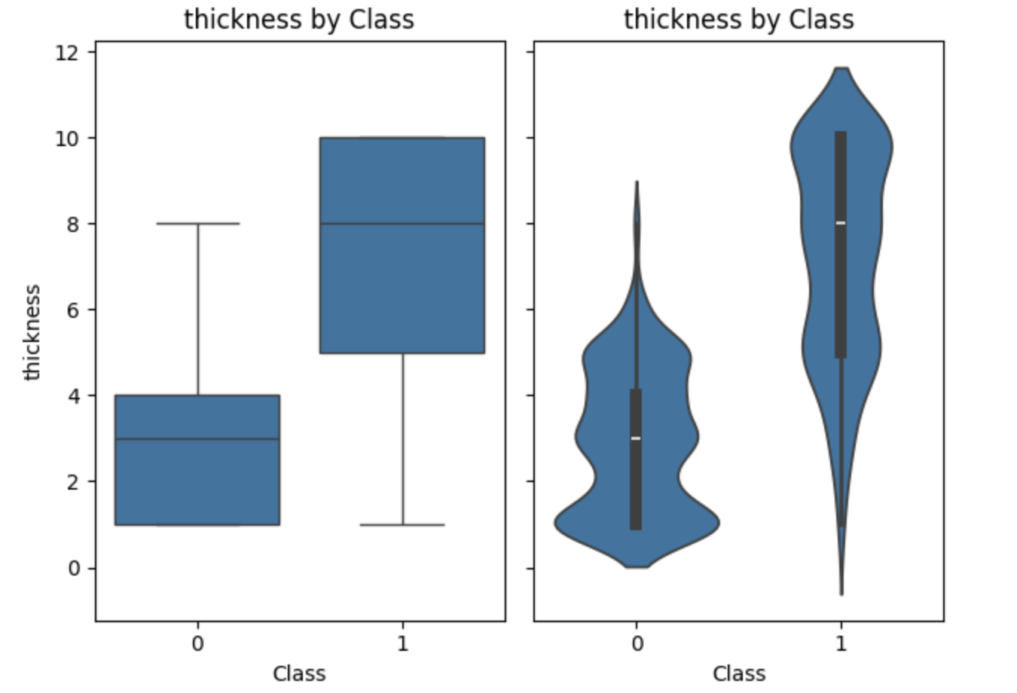
Boxplots & Violin Plots: Benign vs Malignant

Slide 8
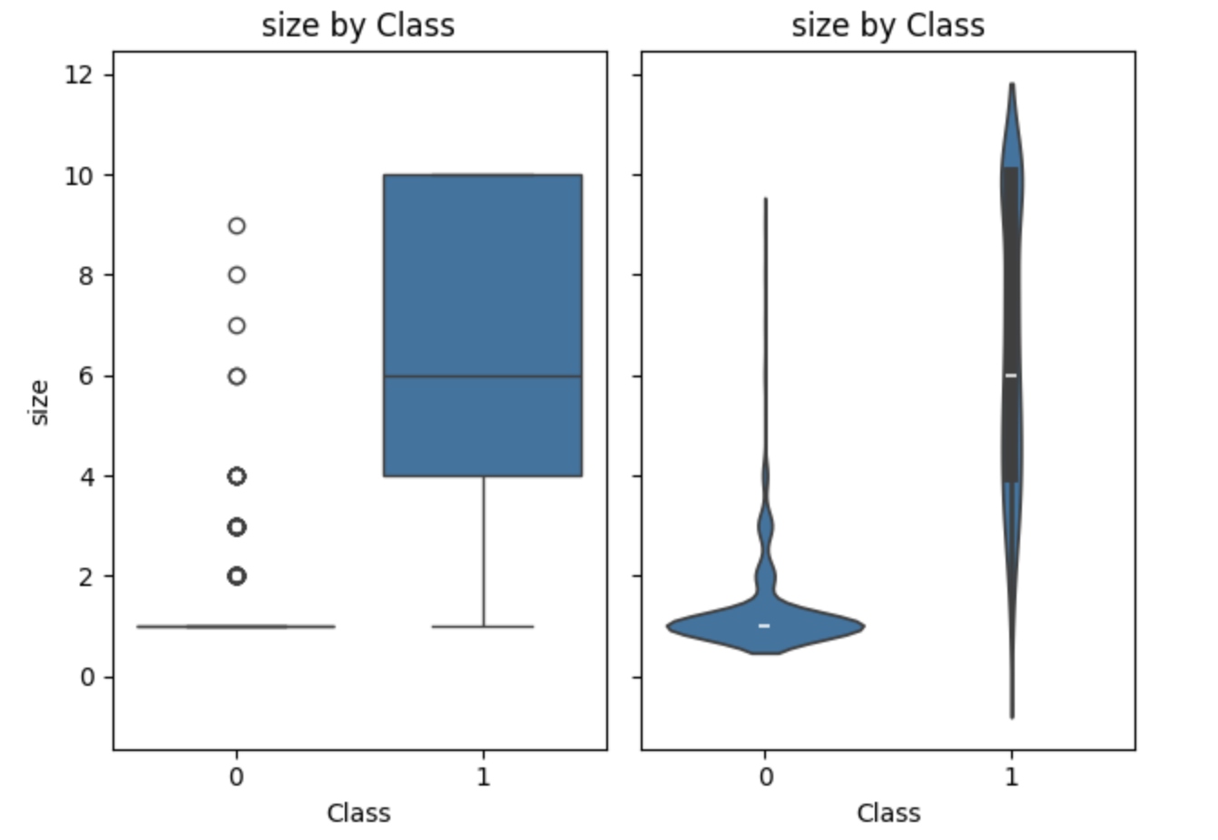
Boxplots & Violin Plots: Benign vs Malignant

Slide 9
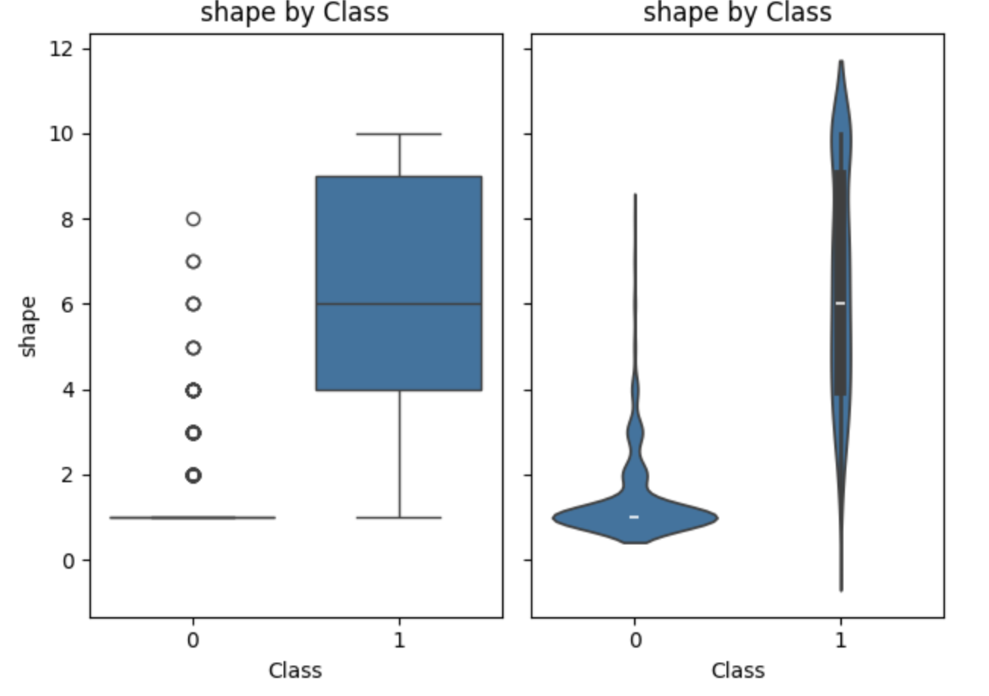
Boxplots & Violin Plots: Benign vs Malignant

Slide 10
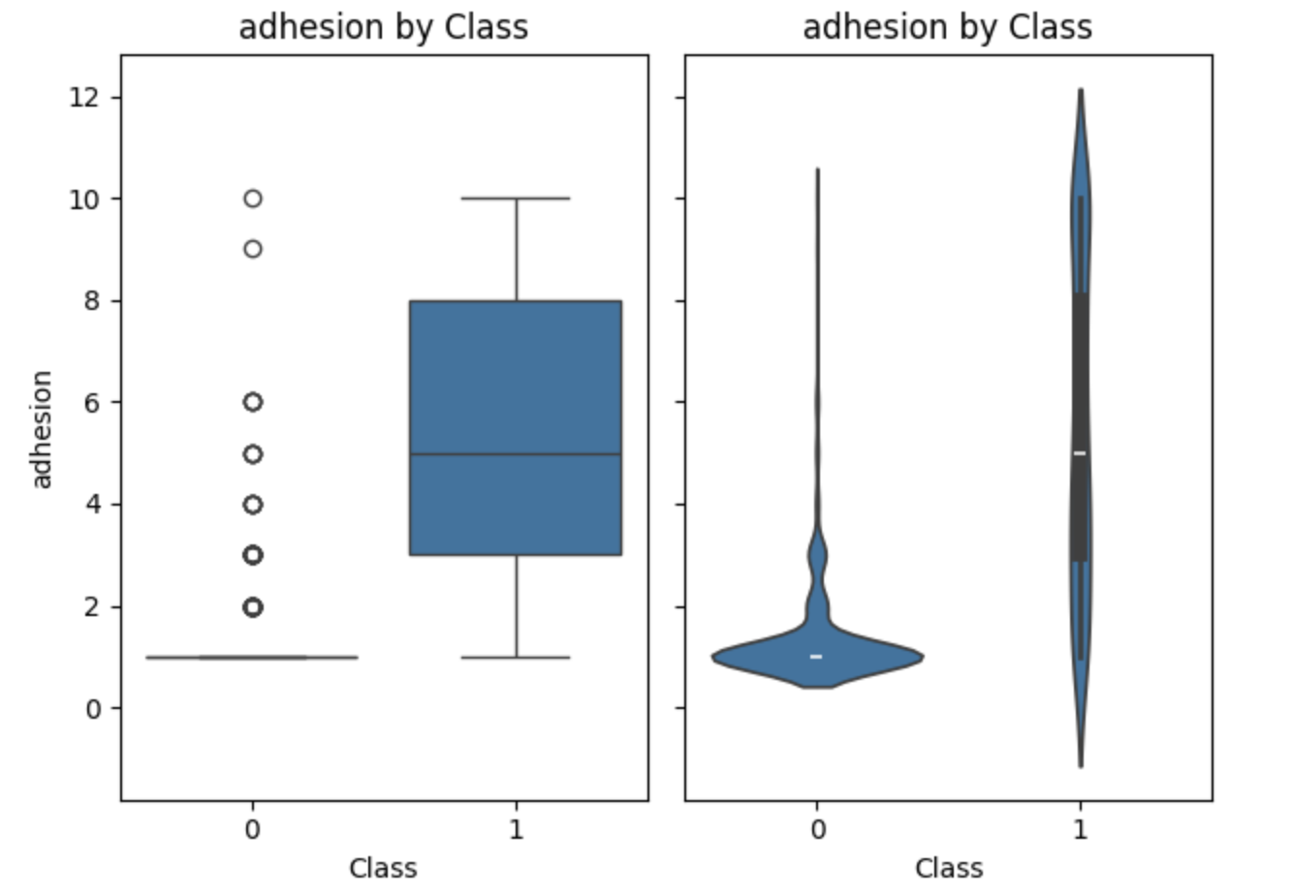
Boxplots & Violin Plots: Benign vs Malignant

Slide 11
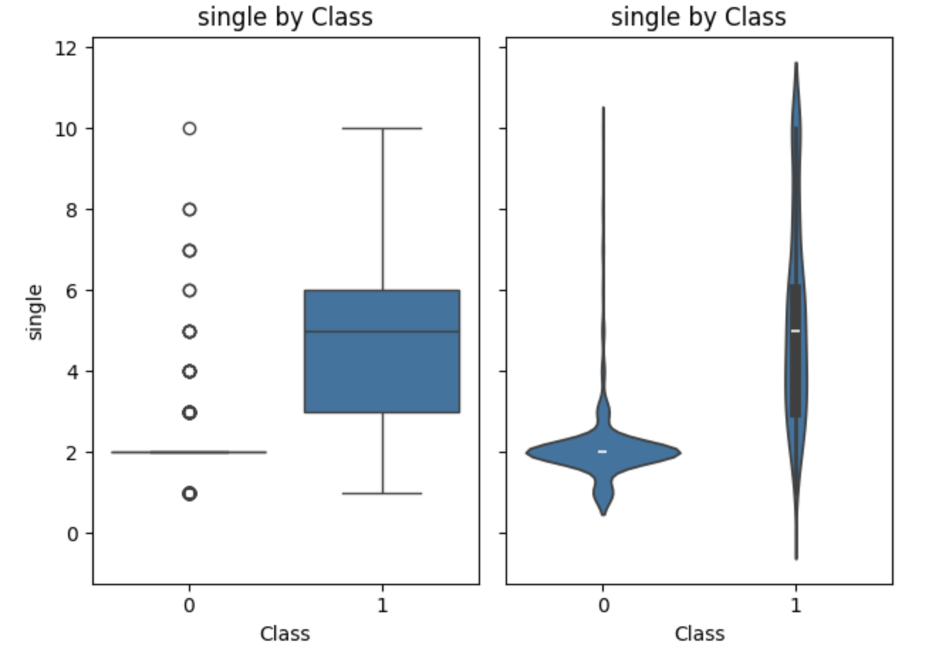
Boxplots & Violin Plots: Benign vs Malignant

Slide 12
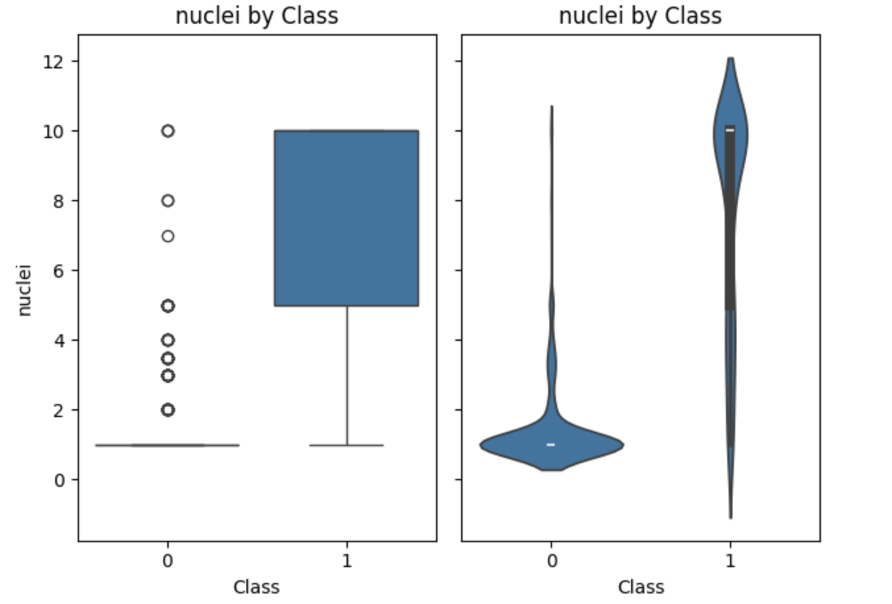
Boxplots & Violin Plots: Benign vs Malignant

Slide 13
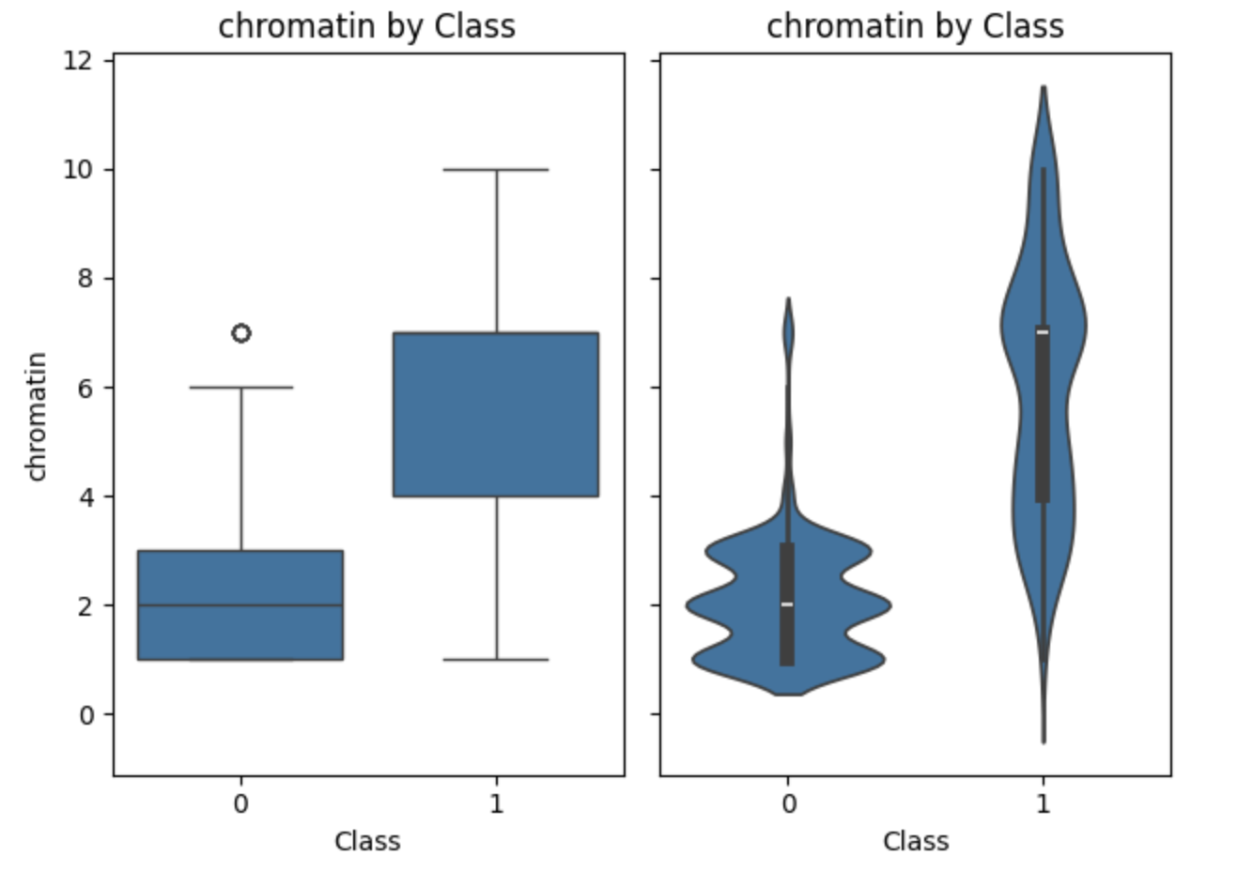
Boxplots & Violin Plots: Benign vs Malignant

Slide 14
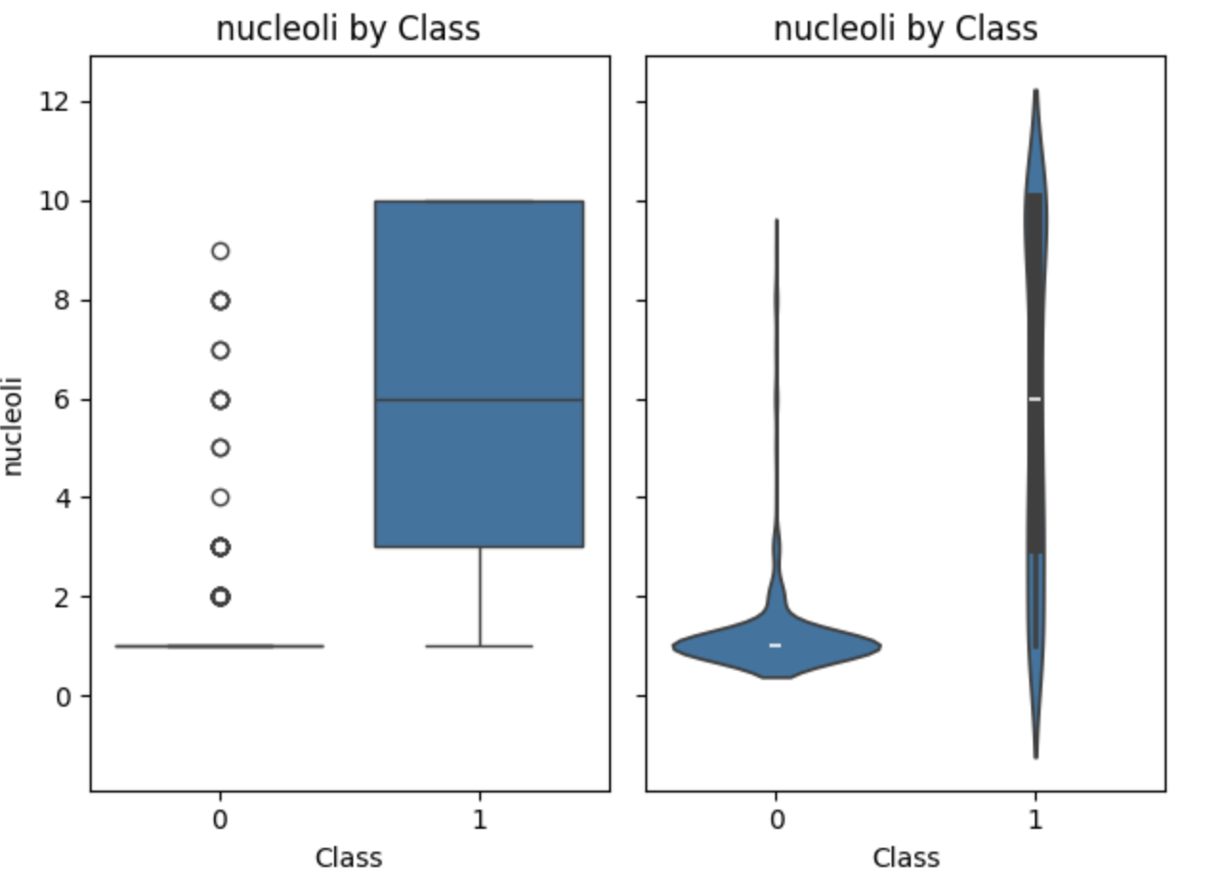
Boxplots & Violin Plots: Benign vs Malignant

Slide 15
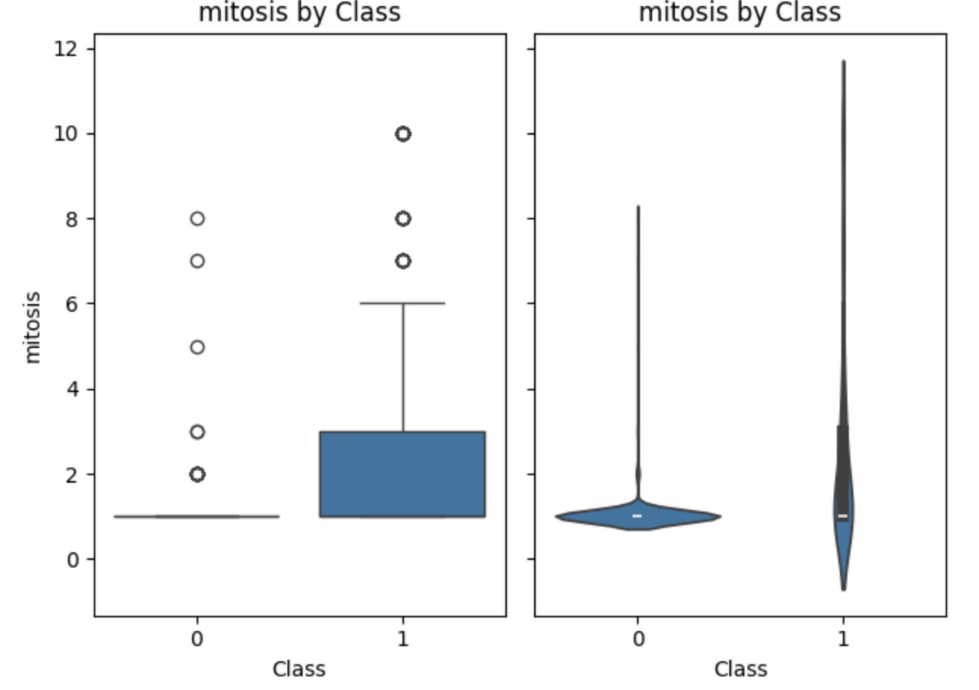
Boxplots & Violin Plots: Benign vs Malignant

Slide 16
Scatter & Pairwise Patterns
When features interact – like shape x size or nucleoli x chromatin – the situation becomes even clearer
Benign and malignant samples form distinct clusters, almost like two groups naturally distancing themselves.
This gives us confidence: cancer alters not just single features, but entire relationships between them

Slide 17
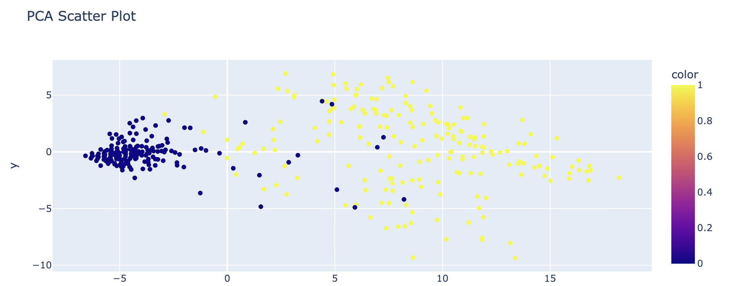
Scatter & Pairwise Patterns

Slide 18
Correlation Heatmap (The Hidden Architecture)
The heatmap reveals connections within the data – how certain abnormalities tend to rise together.
This interconnected structure is what makes cancer detectable: when one feature deviates, several others usually follow.
It reinforces the idea the malignancy is a system-level disruption, not an isolated event.

Slide 19
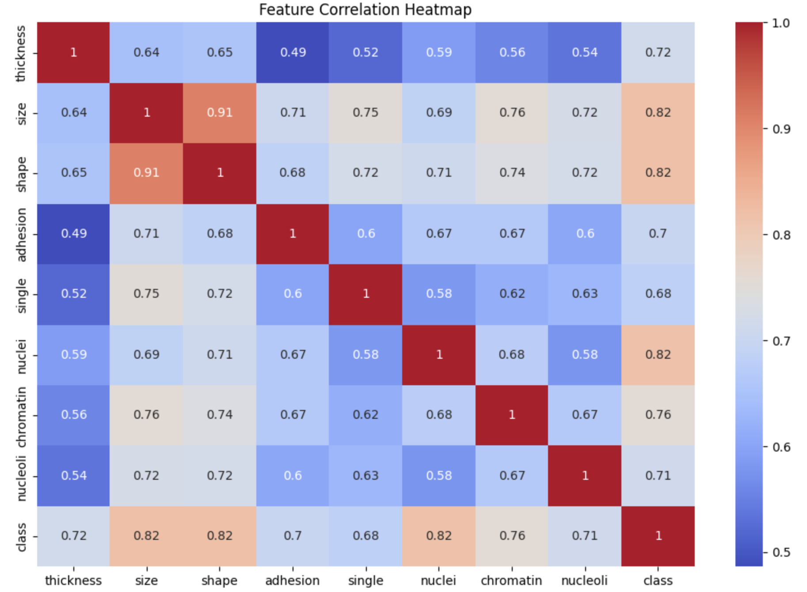
Correlation Heatmap (The Hidden Architecture)

Slide 20
Feature Importance (The Leading Characters)
Machine learning confirms what our visuals hinted: the most influential features include
Cell Shape
Cell Size
Nucleoli Prominence
Chromatin Uniformity

Slide 21
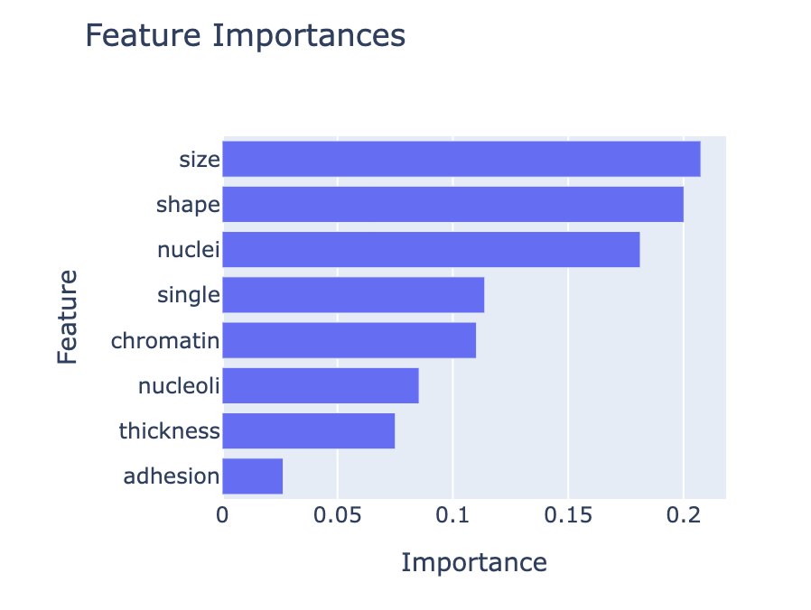
Feature Importance (The Leading Characters)

Slide 22
Model Performance (The Validation)
When tested, the model performed strongly – accurately distinguishing benign from malignant cases.
It doesn’t replace clinical judgment, but acts like a sharp assistant, able to flag cases that deserve a closer look

Slide 23
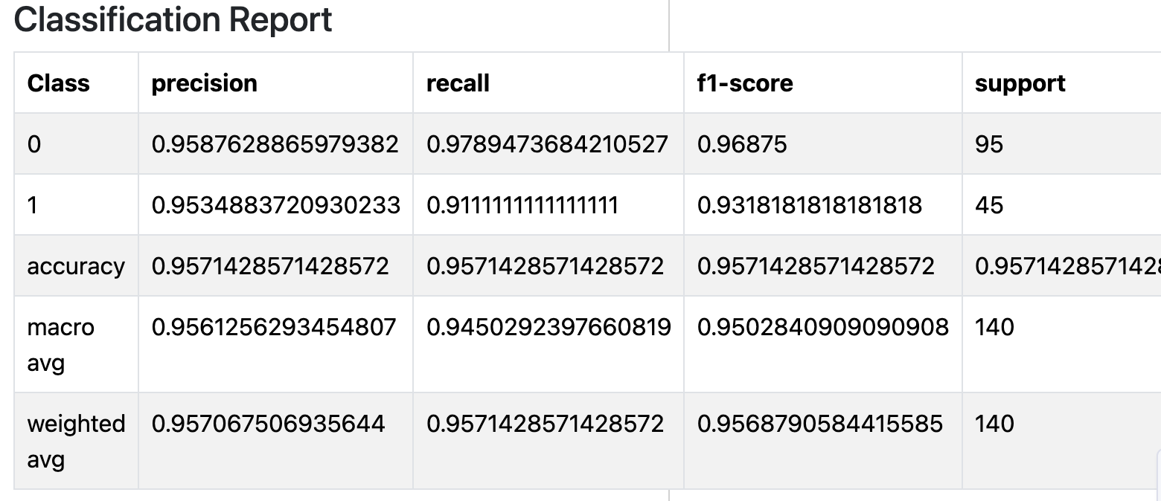
Model Performance (The Validation)

Slide 24
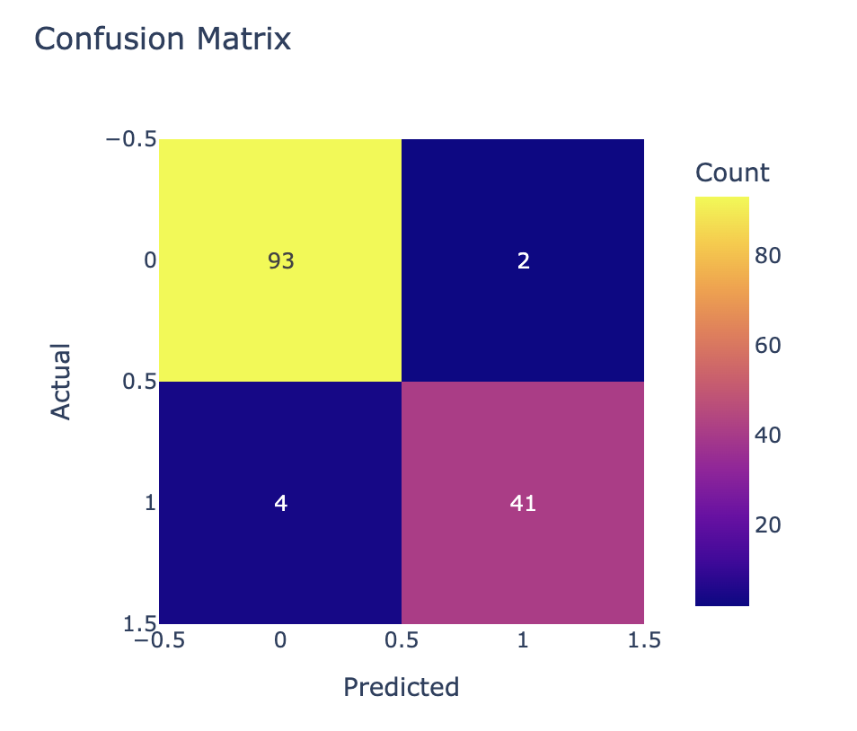
Model Performance (The Validation)

Slide 25
Key Insights
Malignant cells break structural rules in multiple ways
These deviations form recognizable patterns
Combining features paints a clearer picture than any one measurement
Machine learning can amplify early detection

Slide 26
Practical Implications
This isn’t just data; it’s a preview of what diagnostic support could look like in the future
Models like these can help clinicians prioritize cases, reduce oversight and bring consistency to early screening

Slide 27
Recommendations (Next Chapters)
Explore more advanced models for increased precision
01
Gather more samples to strengthen generalization
02
Partner with clinical experts for real-world validation
03
Investigate automation possibilities for lab workflows
04

Slide 28
Conclusions
The data tells a clear story: cancer reveals itself through structural chaos, and with the right tools, we can detect those signals early and accurately.
The analysis provides the foundation for smarter, more diagnostic support systems

